Slide 1
BEHAVIOUR OF LIGHT
TERM THREE 2019

Slide 2
BEHAVIOUR OF LIGHT
Rectilinear propagation of light- Light travels in a straight line

Slide 3

Experiment to show that light travels in a straight line

Slide 4
Shadows
A shadow is a dark area caused by an opaque object blocking light rays
Two types of Shadows
Umbra
Penumbra
Eclipses- are obscuring of light from the sun by the moon or the earth.

Slide 5
Eclipses Cont’d
Types of Eclipses
Solar Eclipse- occurs when the moon is between the sun and the earth. Occurs during the day.
Lunar Eclipse – occurs when the earth is between the sun and the moon. Occurs at night

Slide 6
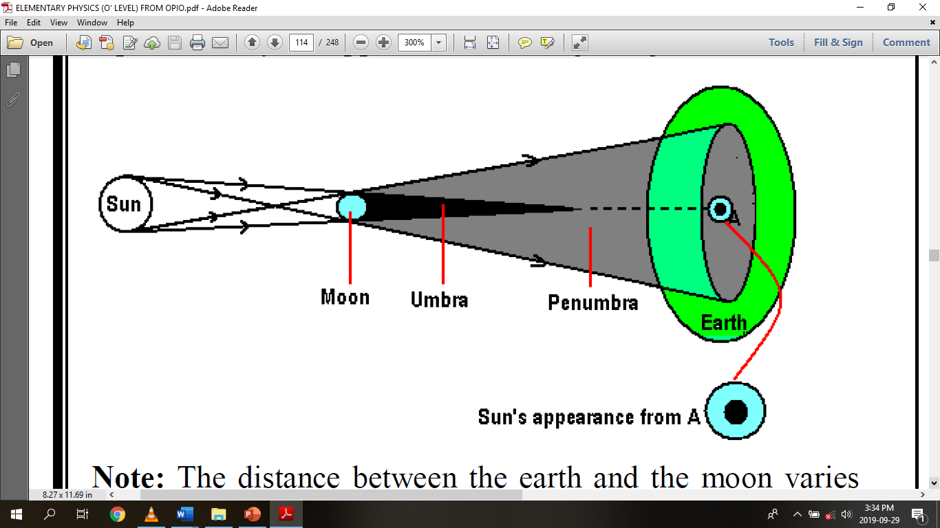

Slide 7
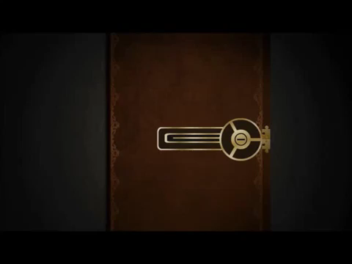
Shadows cont’d

Slide 8
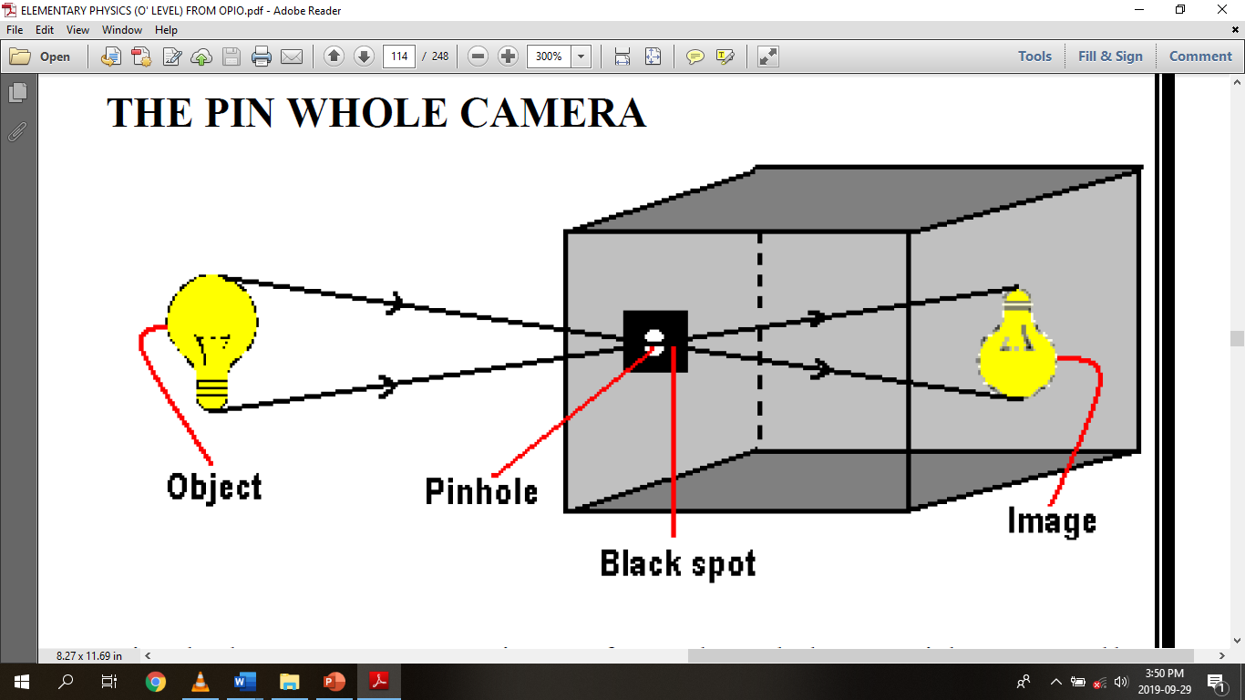

Slide 9
Pin hole camera Cont’d
The size of the image formed in the pin hole camera is inversely proportional to the object distance.
The image distance is always fixed and it is equal to the length of the camera.
The smaller the pi hole, the clearer & shaper is the image

Slide 10
Reflection and Refraction
Reflection is the change in the direction of a ray or a beam when it hits a reflecting surface.
Mirror reflects light
mirror
Transparent medium refracts light
glass

Slide 11
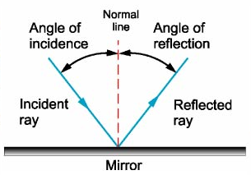
Reflection Cont’d

Slide 12
Laws of reflection
The incident ray, the reflected ray and the normal at the point of incidence all lie in the same plane.
The angel of incidence is equal to the angle of reflection.

Slide 13
Application of reflection at plane mirrors
Plane mirrors are used in;
Saloons and dressing room for admiration
Small vehicles e.g., Cars and taxis to see the activities of passengers aboard.
Bicycles for seeing traffic behind
Periscopes for seeing over obstacles

Slide 14
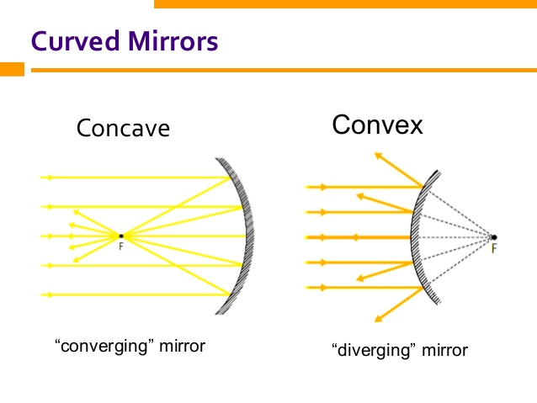
Reflection at curved surfaces

Slide 15
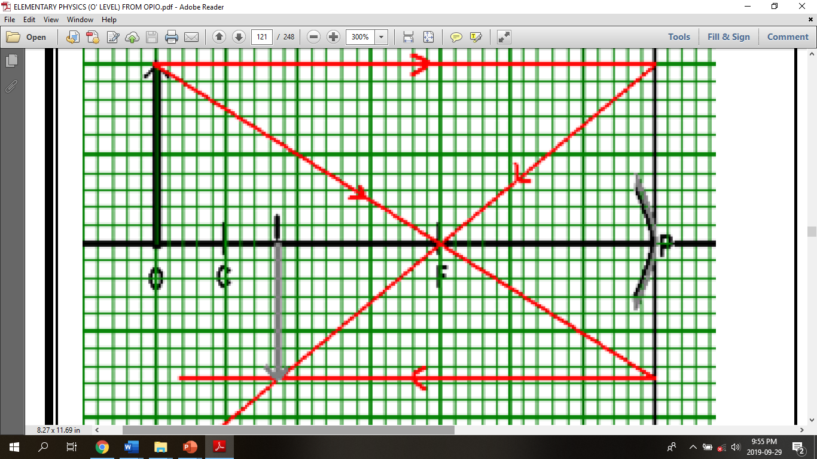
Object O, beyond the center of curvature C

Slide 16
Nature of the image
Position: Formed between F and C
Nature: Real and inverted
Size: Diminished

Slide 17
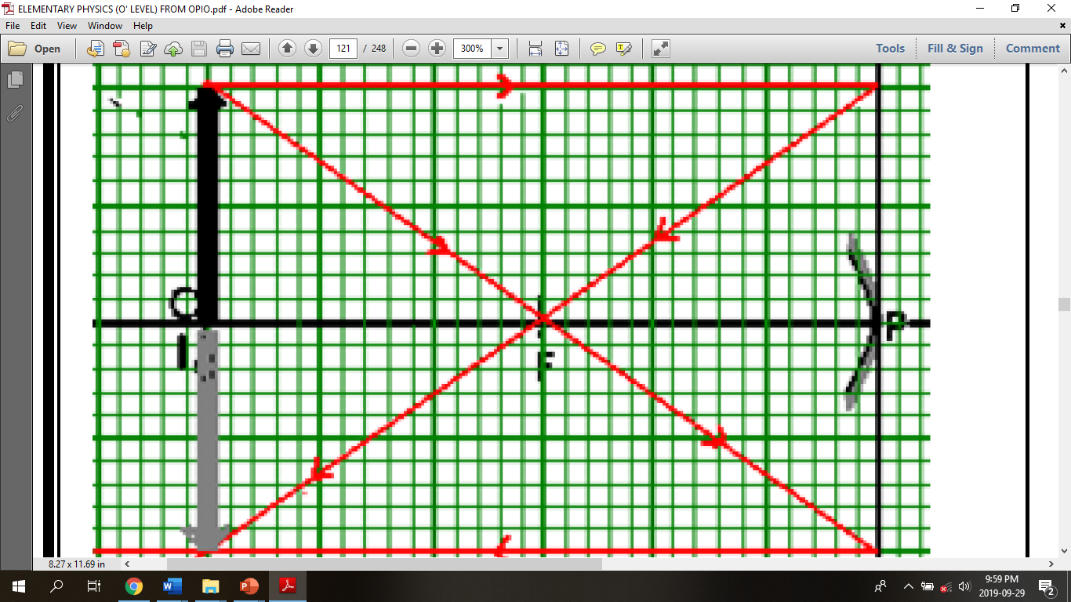
Object O, at the Center of curvature C

Slide 18
Nature of the image
Position: Formed at C
Nature: Real and inverted
Size: Same size as the object

Slide 19
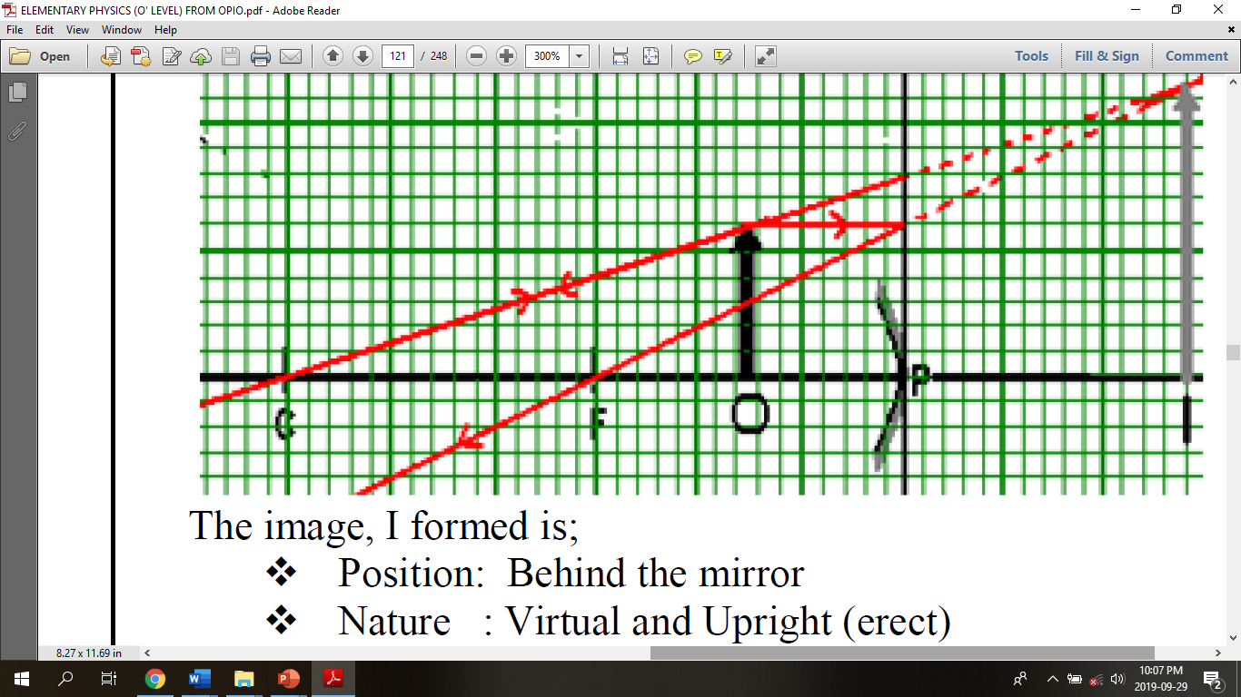
Object at between F and P

Slide 20
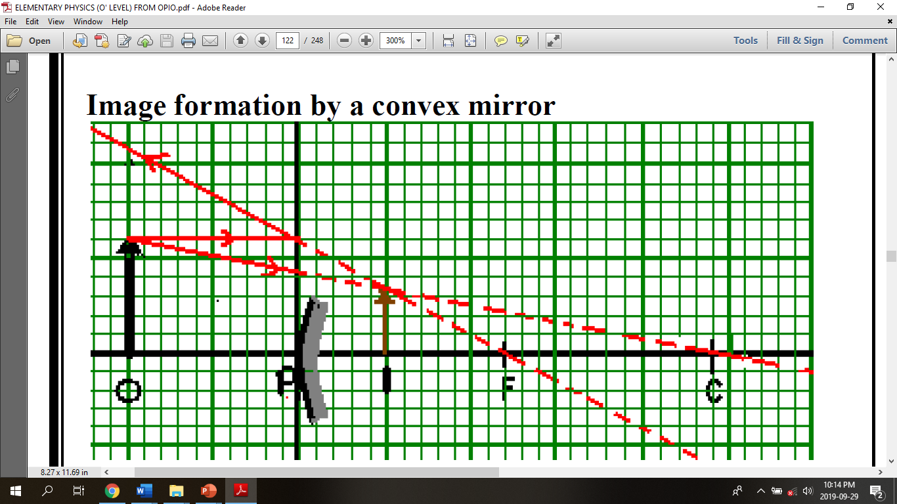

Slide 21
Application of convex mirrors
Convex mirrors are used ;
As driving mirrors for seeing traffic behind.
In supper markets to observe the activities of the customers.
At security check points to inspect under Vehicles.

Slide 22
Applications of concave mirrors
Concave mirrors as used as;
Dentist mirrors
Shaving mirrors
Reflectors in Telescopes and car head lamps

Slide 23
REFRACTION
Is the change in the direction of light ray when it travels from one medium to another.

Slide 24
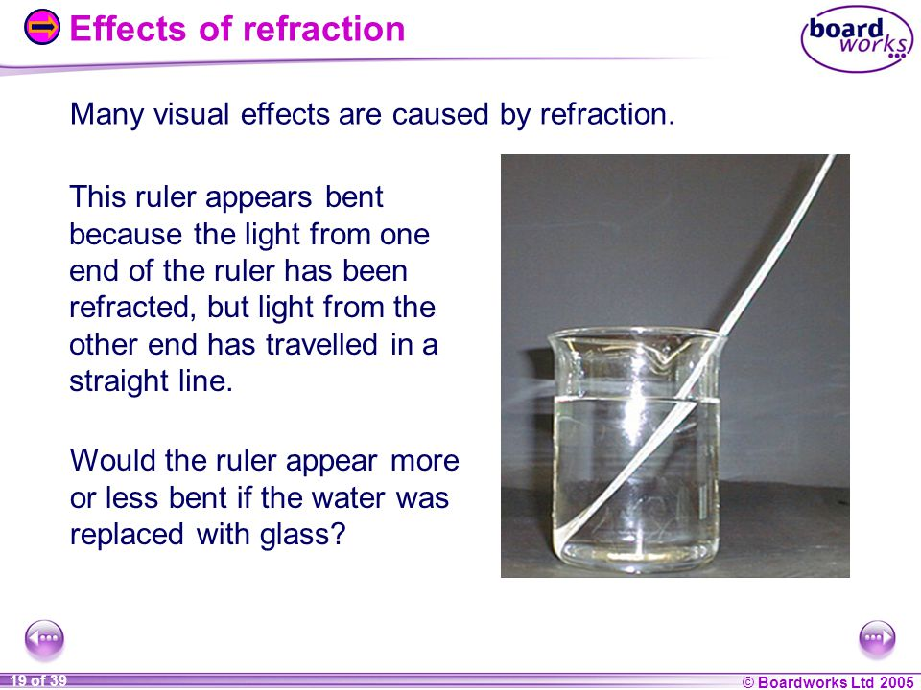

Slide 25
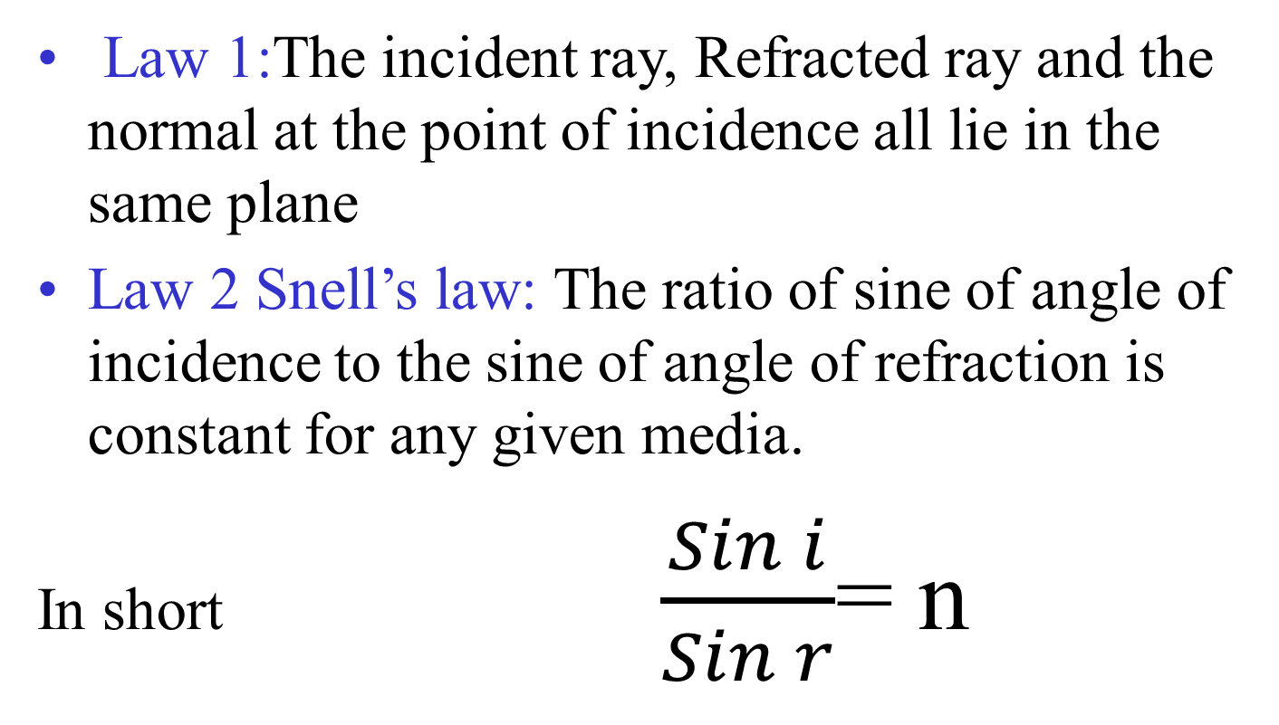
Laws of refraction

Slide 26
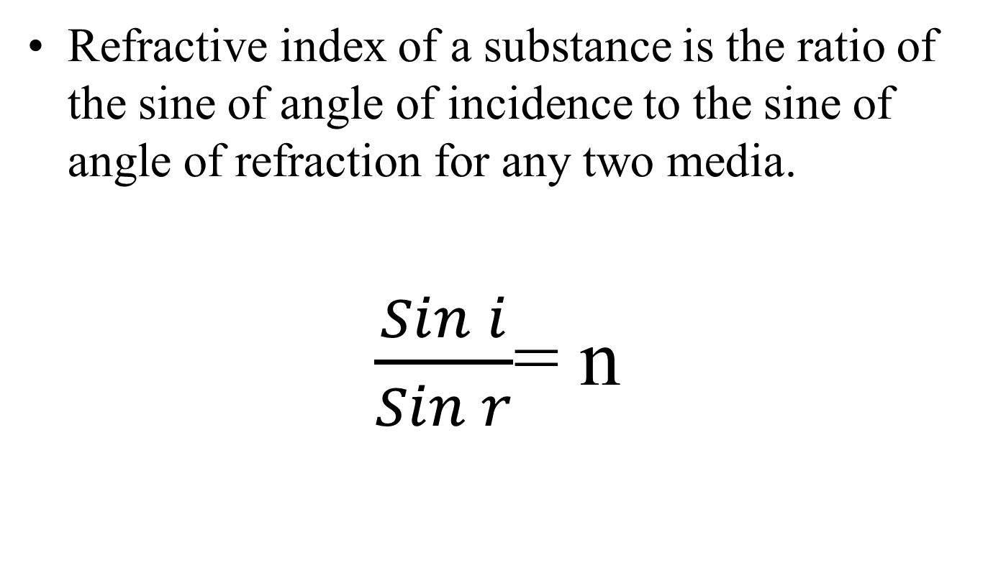
Refractive index

Slide 27
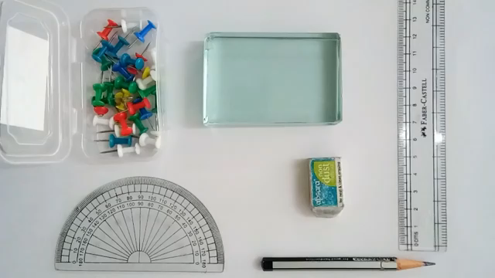
Expt to determine n for glass slab.

Slide 28
Total internal reflection and the critical angle
Consider monochromatic light propagating from a dense medium to a less dense medium at a small angle of incidence.
When the angle of incidence is increased gradually, a state is reached when the refracted ray grazes the boundary between the two media

Slide 29

Total internal reflection cont’d

Slide 30

Total internal reflection Cont’d

Slide 31
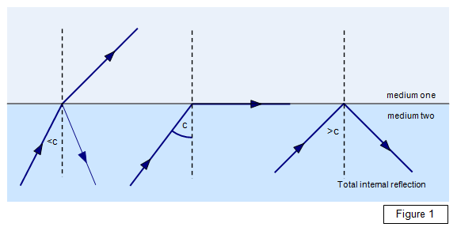
Total internal reflection cont’d

Slide 32
Total internal reflection cont’d
Total internal reflection is the reflection of light back into the same medium for a ray of light travelling from a denser medium to a less dense medium.

Slide 33
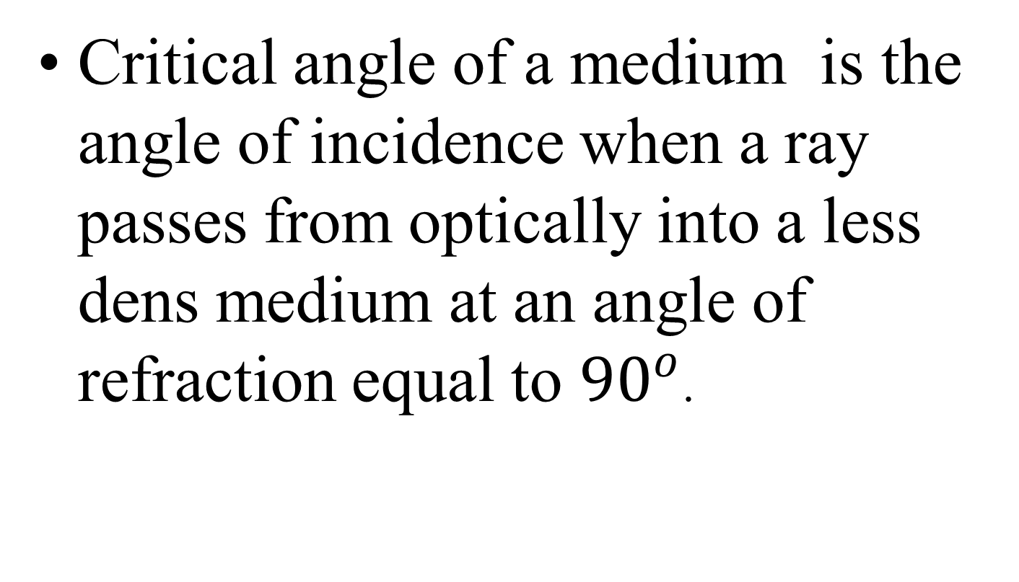
Critical angle
Critical angle of a medium is the angle of incidence when a ray passes from optically into a less dens medium at an angle of refraction equal to ${90}^{o}$.

Slide 34
Conditions to total internal reflection.
The ray must be traveling from a dense medium to a less dense medium. E.g., from glass to air.
The angle of incidence must be grater than the critical angle of the medium.

Slide 35
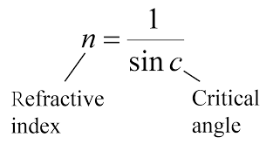
Relationship between Critical angle and n

Slide 36
Example 1
For glass-air interface, the critical angle is 42º.
At critical angle, angle of refraction is 90º, so, by the laws of refraction,
1
sin r
sin i
sin 90º
sin C
n =
=
n x sin C = 1
1
n
sin C =

Slide 37


What is the critical angle...
… for water-air interface?
The refractive index of water is 1.33
1 ÷ 1.33 = 0.75
sin⁻¹ 0.75 = 48.8º
=> C = 48.8º
Check :
sin C = sin 48.8º = 0.75
1 ÷ 0.75 = 1.33
I can do it,
so can you!
1
n
sin C =

Slide 38
Critical angle (5)
For glass, the refractive index is 1.5;
C = sin⁻¹ (1÷1.5)
Critical angle = 42º
For water, the refractive index is 1.33;
C = sin⁻¹ (1÷1.33)
Critical angle = 48.8º
1
n
1
n
C = sin⁻¹ ( )
sin C =

Slide 39
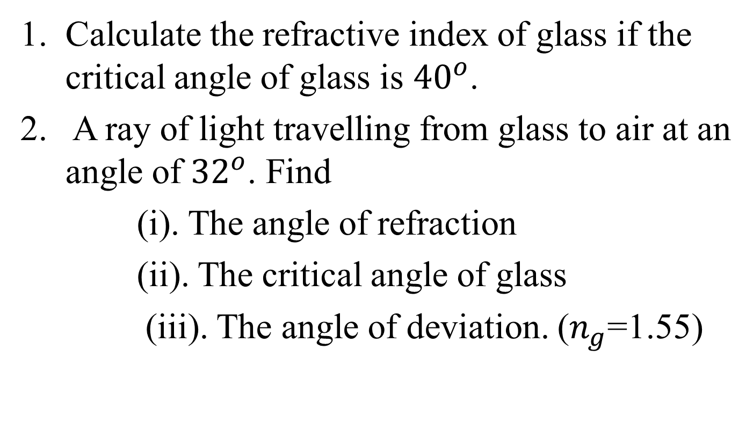
Exercise
Calculate the refractive index of glass if the critical angle of glass is ${40}^{o}$.
A ray of light travelling from glass to air at an angle of ${32}^{o}$. Find
(i). The angle of refraction
(ii). The critical angle of glass
(iii). The angle of deviation. ($n_{g}$=1.55)

Slide 40
Applications of total internal reflection.
1.The fish view.
The fish enjoys a wider field of view as it views all objects both in water and above the water surface.
Objects above the water surface are viewed as a result of refraction while those under water are viewed as a result of total internal reflection.

Slide 41

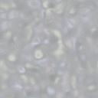
Fish eye view (1)
Objects above are viewed as a result of
refraction
totally internally
reflected ray
water

Slide 42
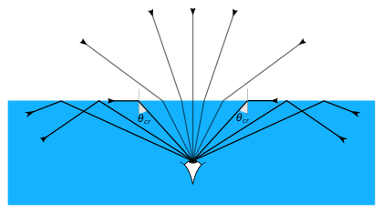
The fish view

Slide 43
2. Light pipes and optical fibers
Light can travel and can be trapped by total internal reflection inside a bent glass tube and pipe along the curved path.
If several rays are trapped together, a flexible light pipe is obtained and can be used to light up some awkward sport for inspection.

Slide 44
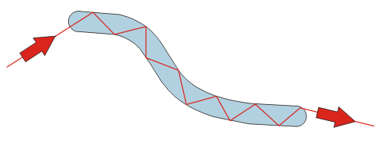
Optic fibers cont’d

Slide 45
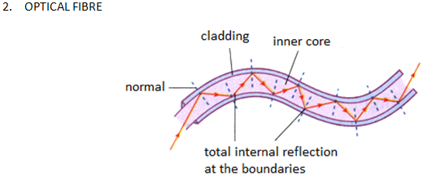

Slide 46
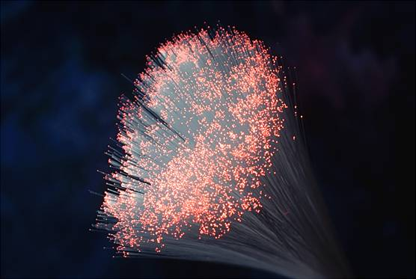
Optic fibers cont’d

Slide 47
Optic fibers cont’d

Slide 48
3. The mirage
A mirage is the appearance of pools of water on the ground a head on hot days caused by refraction and total internal reflection.
Mirages are usually seen in deserts and on tarmac roads on very hot days. How ever they disappear when we get to the spots where they appear.

Slide 49
The mirage Cont’d
This is because air above the ground is hotter (less dense) than air higher up.
Light from the sky is gradually refracted towards the horizontal after passing through different lays of air of decreasing densities.
The angle of incidence becomes great and greater and eventually light meets the layer of air near the ground at an angle greater than the critical angle so total internal reflection takes place.

Slide 50
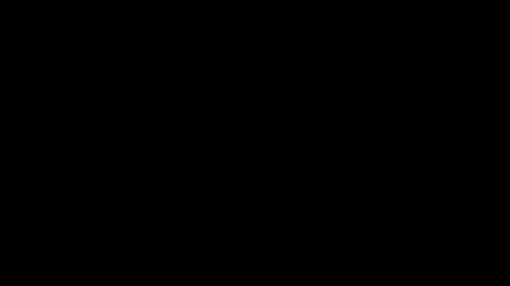
The mirage cont’d.

Slide 51
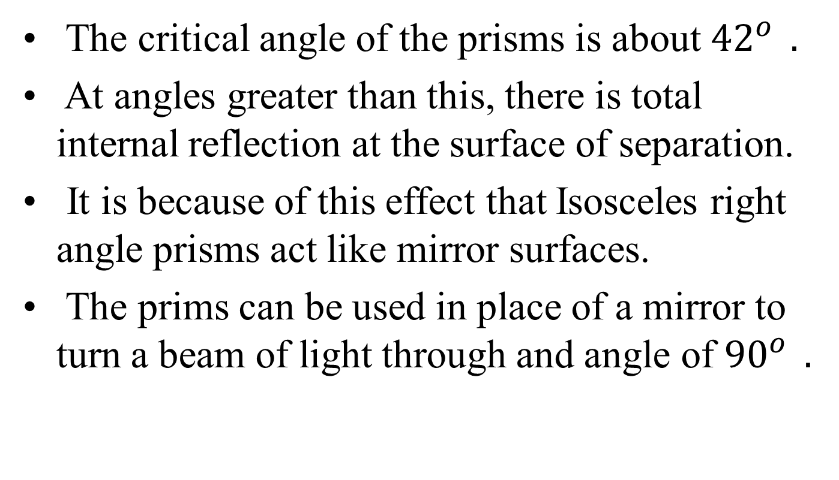
4.Total internal reflection in prisms
The critical angle of the prisms is about ${42}^{o } .$
At angles greater than this, there is total internal reflection at the surface of separation.
It is because of this effect that Isosceles right angle prisms act like mirror surfaces.
The prims can be used in place of a mirror to turn a beam of light through and angle of ${90}^{o } .$

Slide 52
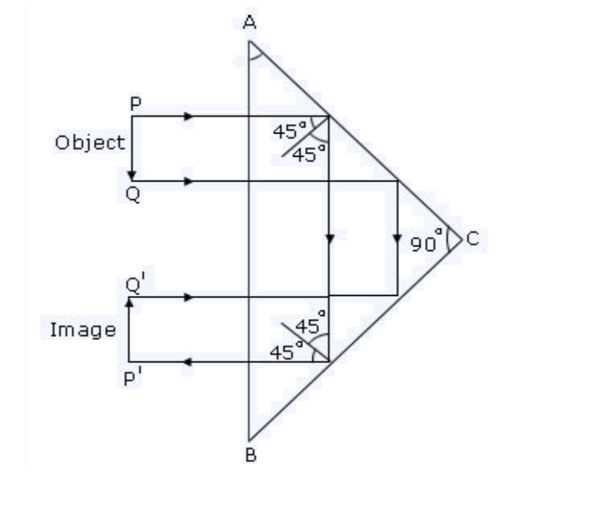
4.Total internal refletion in prims

Slide 53
Totally reflecting prims
Prisms are preferred to be used in submarine periscopes because ;
They produce clear image.
They do not tarnish and deteriorate the image like mirrors. Plane mirrors produce multiple images .

Slide 54
5.Radio waves.
When radio waves are sent from a transmitting station on the earth, the waves soon enter a region of high density of electrons called an Appleton layer well above the earth.
The radio waves are then refracted away from the normal in this layer.
At some height or altitude, total internal reflection occurs and the waves begin to move downwards towards a receiving station on earth

Slide 55
Real and Apparent depth

Slide 56
Real and Apparent depth
Real depth is the depth where the object is actually placed under the transparent medium.
Real depth is the actual height of the medium in its desired dimensions.
Apparent depth is where the object appears to be when observed through a transparent medium of different optical density to that of the surrounding.

Slide 57
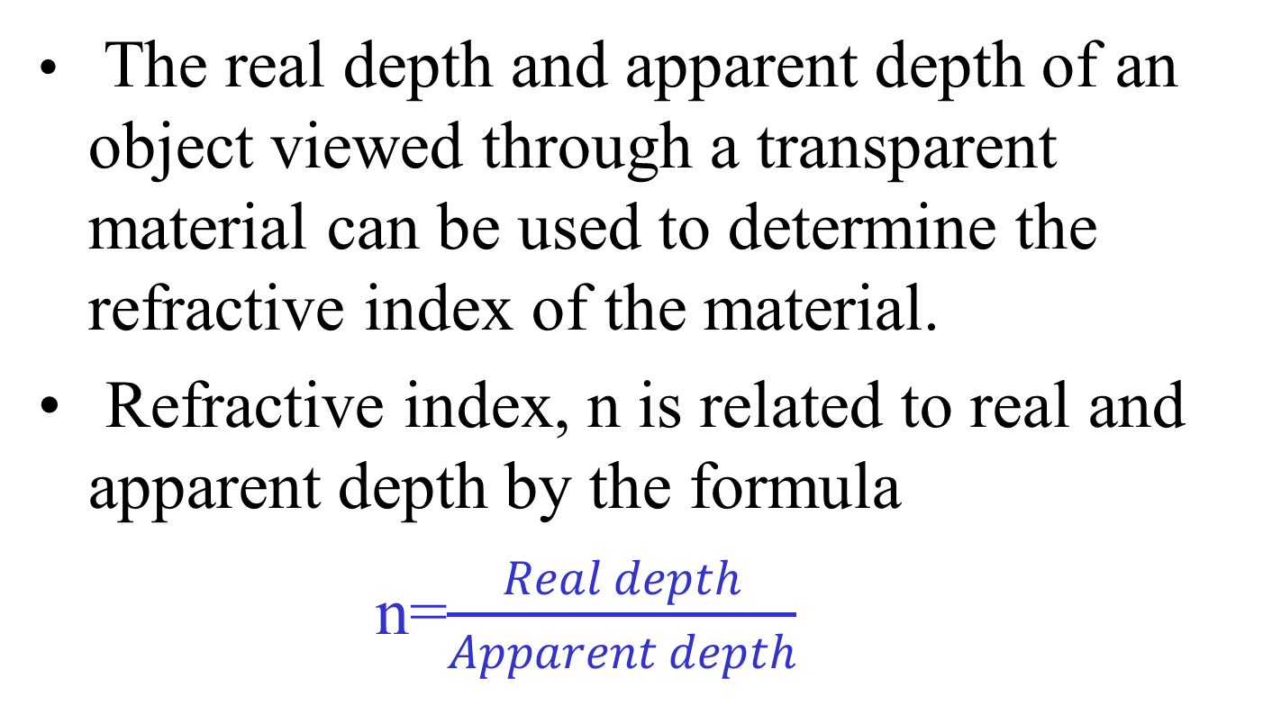
Refractive index
The real depth and apparent depth of an object viewed through a transparent material can be used to determine the refractive index of the material.
Refractive index, n is related to real and apparent depth by the formula
n=$\frac{Real depth}{Apparent depth}$

Slide 58
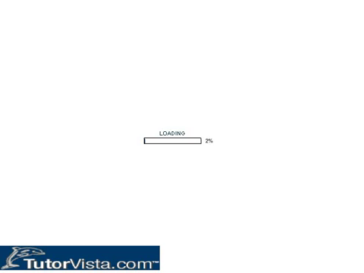
Real and apparent depth

Slide 59
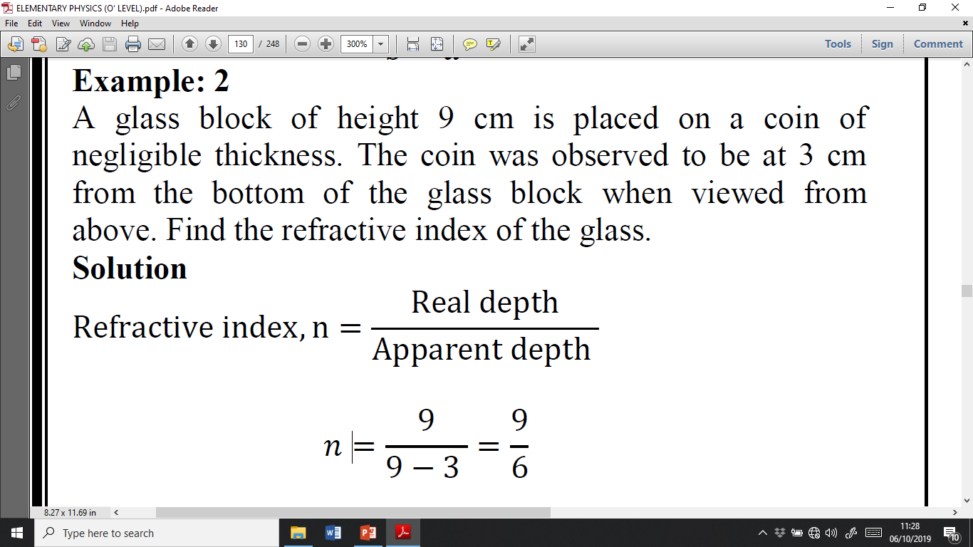
Example

Slide 60
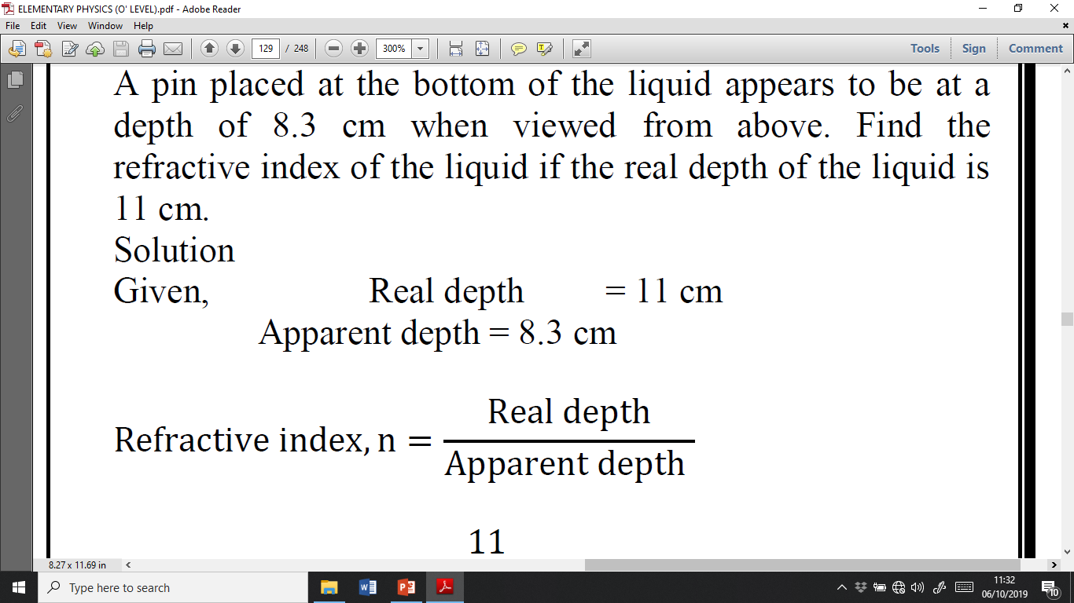
Example 2

Slide 61
Effects of refraction
Ponds and pools appear shallower than their actual depth.
This is because light rays from the bottom are refracted away from the normal at the water to air boundary

Slide 62
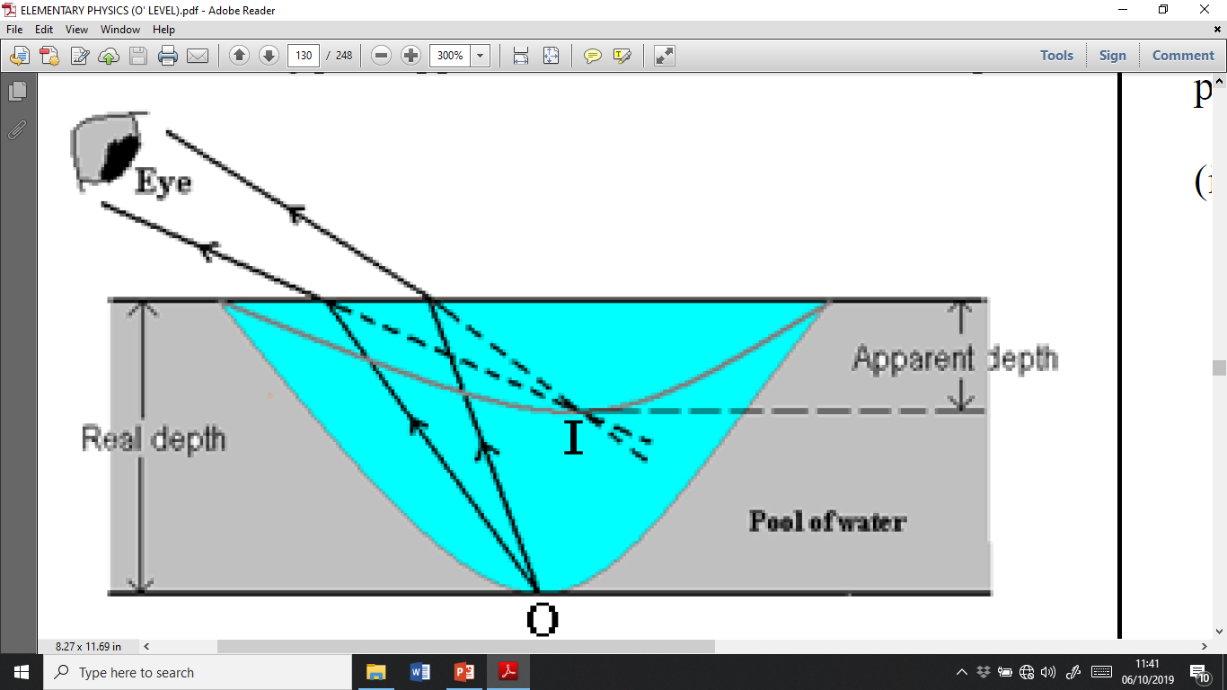

Slide 63
Effects of refraction Cont’d
A stick appears bent when partially immersed in a liquid.
An object viewed in a dense medium like water appears farer away than it actual distance.
Stars seem to be higher than they are.

Slide 64
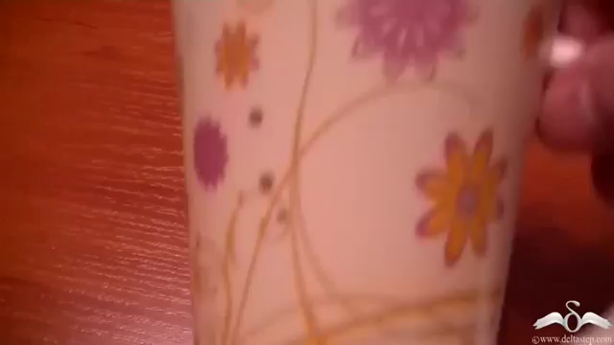
Effects of refraction

Slide 66
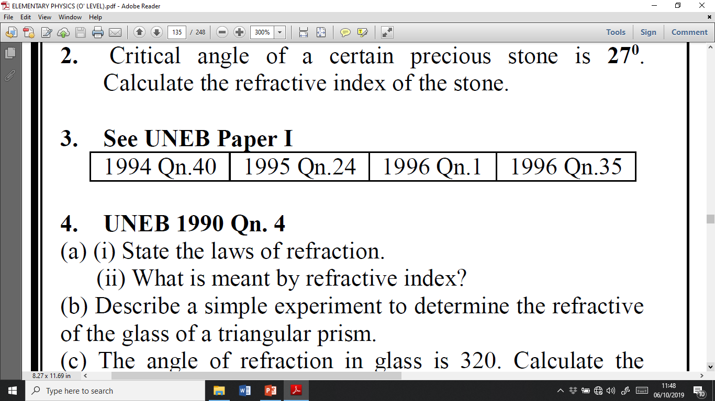
Revision questions

Slide 67
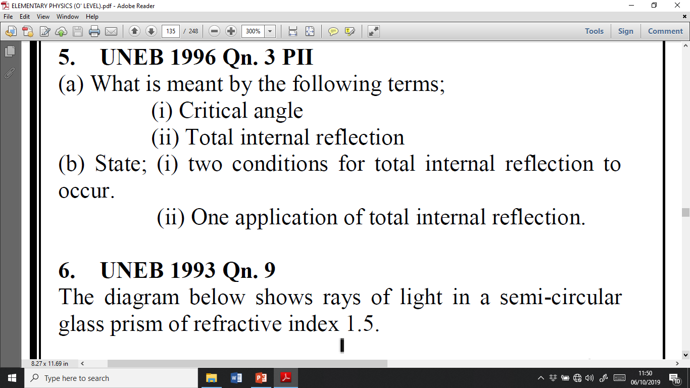

Slide 68
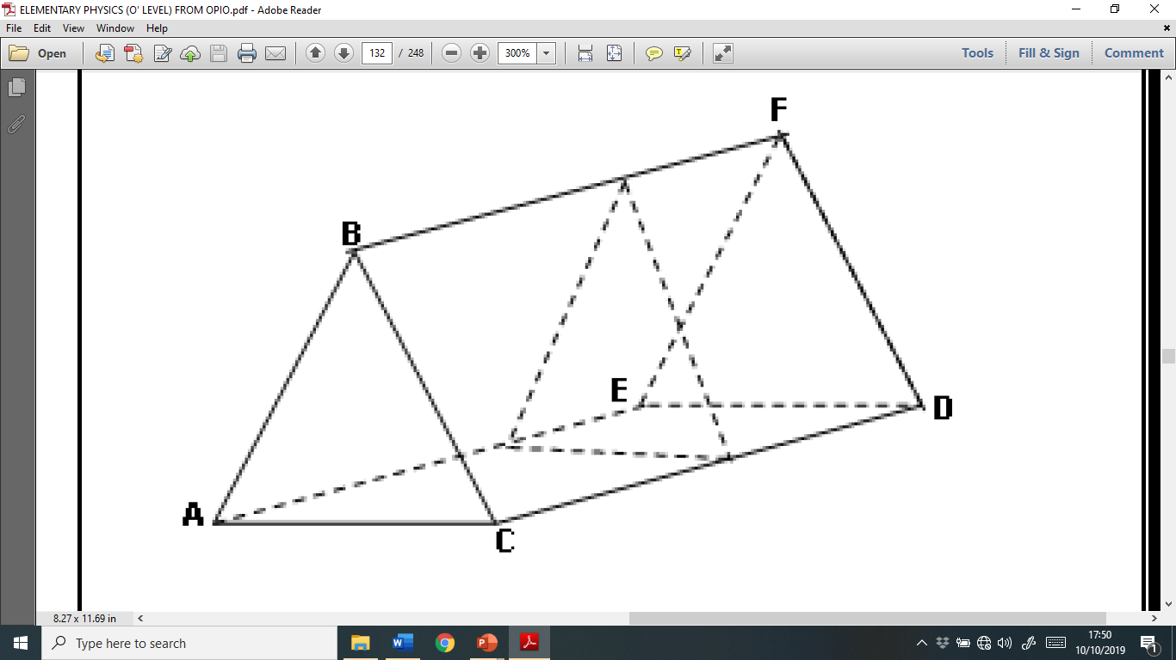
REFRACTION IN GLASS PRISMS
A prism is a three dimensional solid with two parallel triangular faces.

Slide 69
Deviation by the prism
When light passes through a glass prism, the direction of the emergent ray is altered from the initial direction.
The angle through which the direction is altered is called deviation, d.

Slide 70
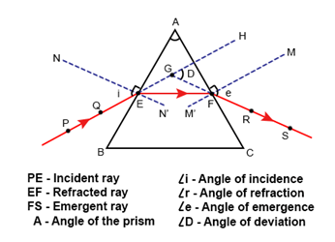
Deviation by the Prism

Slide 71
Dispersion of light
Dispersion is the separation of white light into its component colors.
When white light passes through the prism, it is deviated and separated into seven colors.
This is because of the refractive index of glass being different for each color.

Slide 72
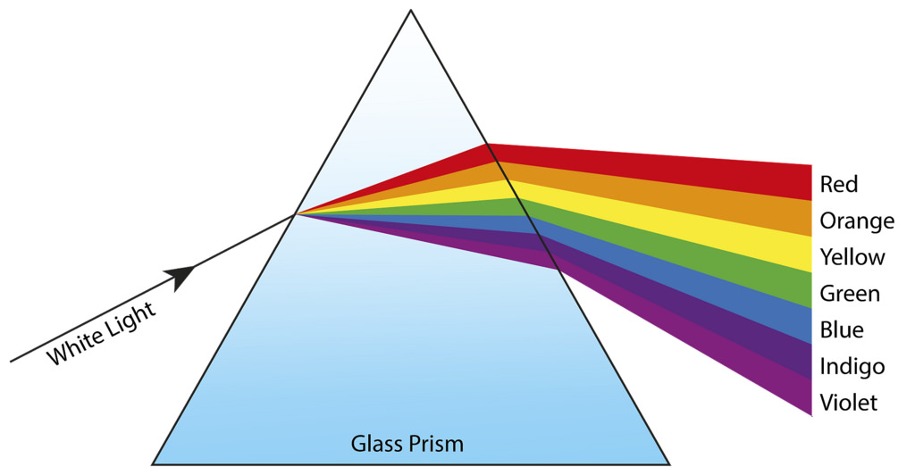
Dispersion of light Cont’d

Slide 73
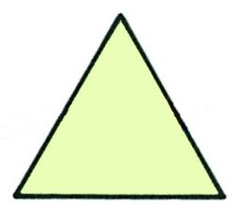
Here is a glass prism:
A ray of white light arrives

Slide 74
What happens to the ray of light?
It is (mainly) reflected or refracted ?
away from or towards
the normal the normal
But different colours are refracted by different angles.

Slide 75

In fact, the ray is :
devi
ated
(bent through an angle), and
dispersed (split up into separate colours)
like this.

Slide 76
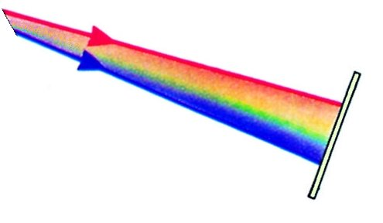
R
What happens now?
V
screen
Red is deviated most / least ?
least
Violet is deviated most / least ?
most

Slide 77
R
There is a spectrum
on the screen:
V
screen
Red Orange Yellow Green Blue Indigo Violet
ROY G BIV

Slide 78
Facts about dispersion of light by a prism
Red bends least and violet bends most.
White light is a mixture of seven colors.
The band of seven colors formed is called the spectrum.
The spectrum formed is impure due to overlapping colors.
A pure spectrum can be obtained in the laboratory

Slide 79
Expt to produce a pure spectrum
A pure spectrum in the one in which light of one color only forms on the screen without overlapping.
An illuminated slit is placed at the principal focus of the converging lens so a parallel beam of white light emerges and falls on the prism.
Refraction through the prism splits up light into separate parallel beams of different colors each of which is brought to its own focus.

Slide 80
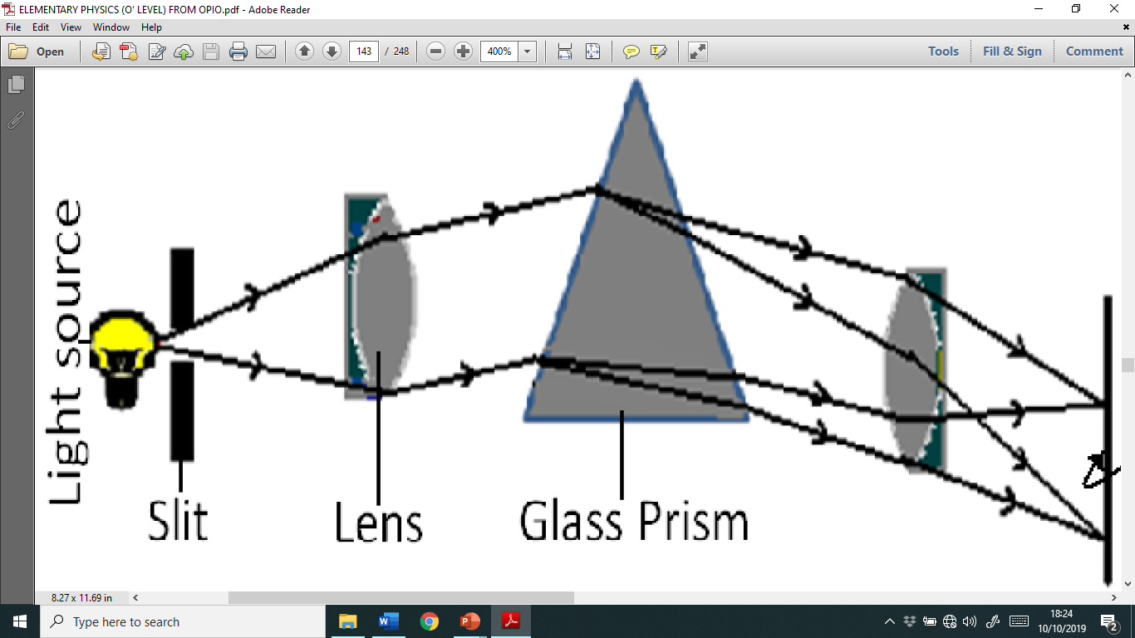
Pure spectrum

Slide 81

Pure spectrum

Slide 82
COLORS
Color is the appearance of an object that results from there ability to reflect light.
TYPES OF COLORS
Primary colors. These are colors that can not be obtained by mixing other colors.
Examples of primary colors are, red. Green, blue

Slide 83
Types of Colors cont’d
ii) Secondary colors. These are colors got by mixing other colors.
Examples include
Yellow, Magenta, Cyan

Slide 84
COLORS CONT’D

Slide 85
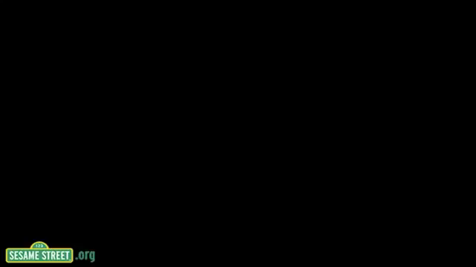
Colors cont’d

Slide 86
Color addition
When two colors of light are projected on the screen, they overlap to give a different color.
The new color is said to be formed by color addition.
All the three primary colors intersect to give white light.
Two primary colors add up to produce a secondary color.

Slide 87
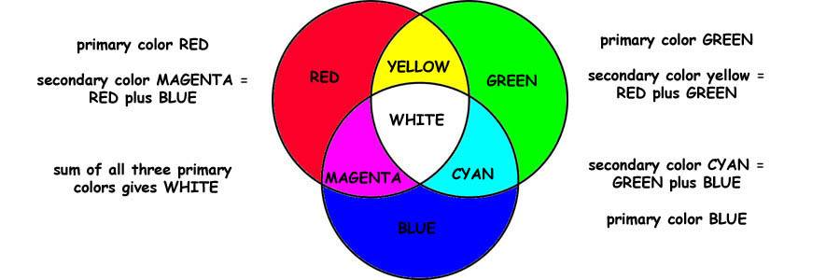
Color Addition

Slide 88
Types of colors cont’d
iii) Complimentary Colors. This refers to a pair of colors (a primary & a secondary color ) which when mixed together give white light.
Examples

Slide 89
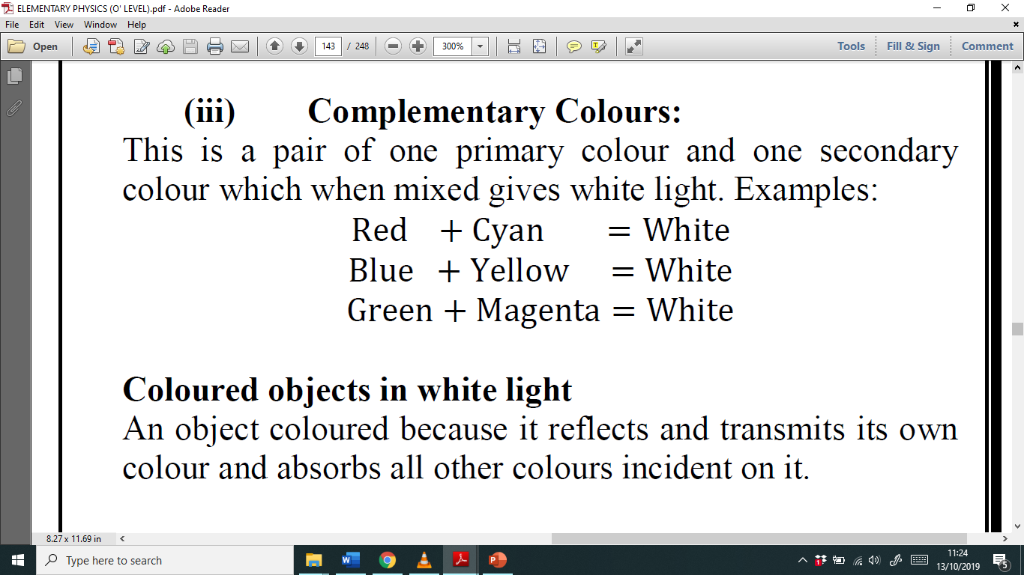

Slide 90
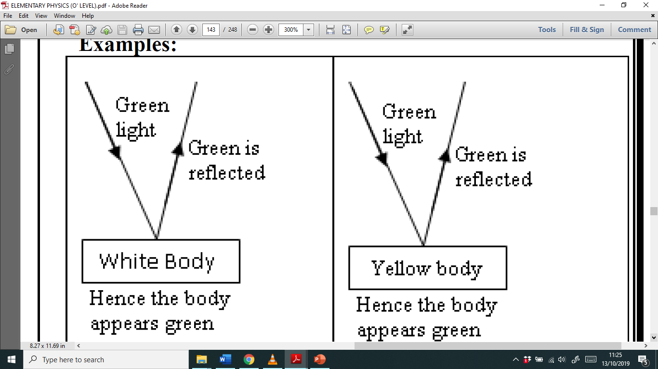

Slide 91
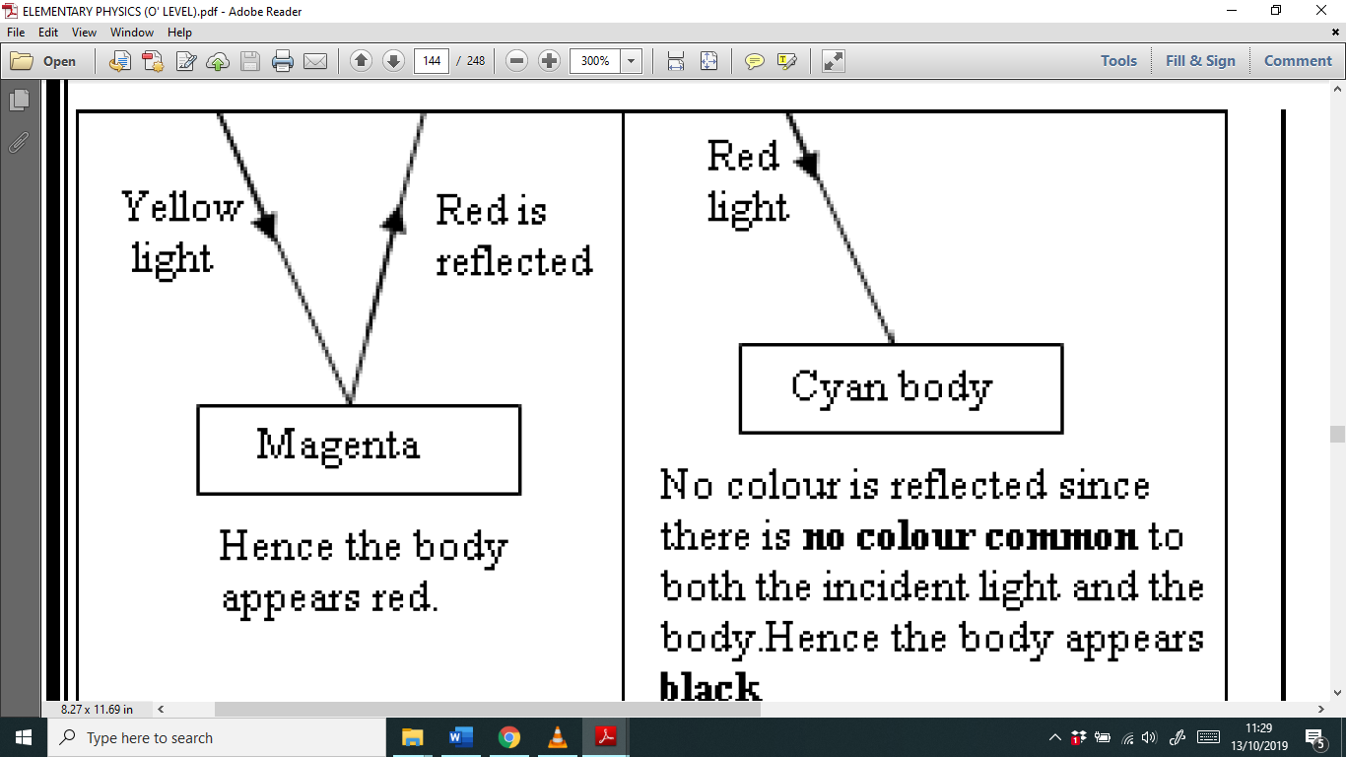

Slide 92

End

